Slide 1
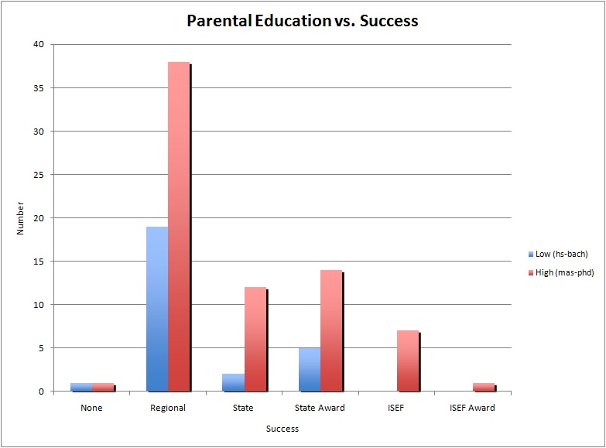
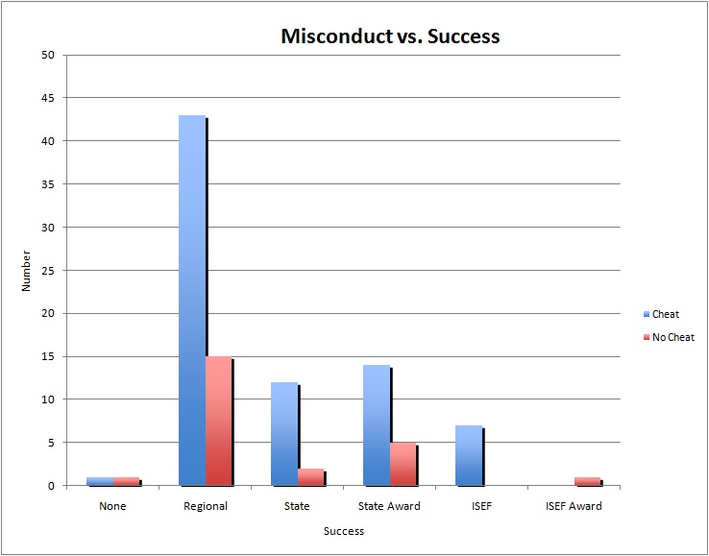
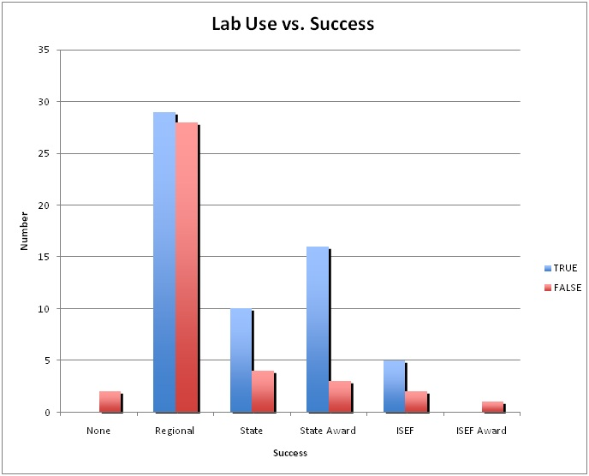
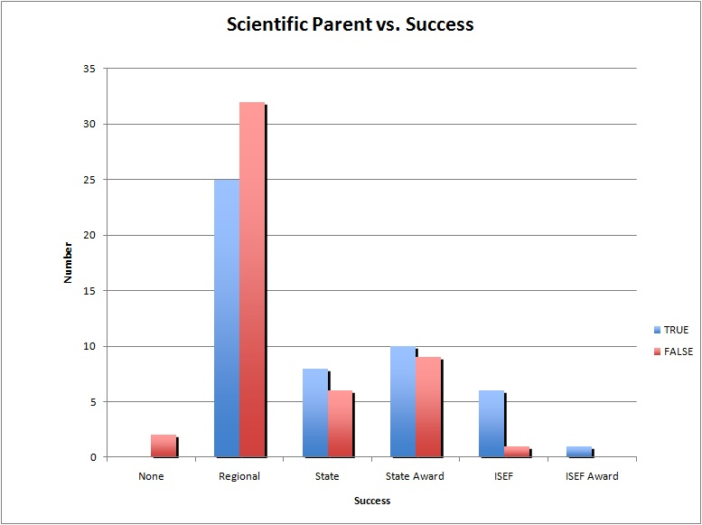
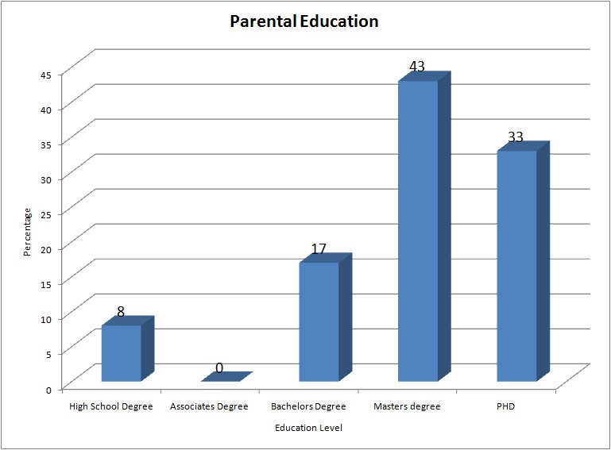
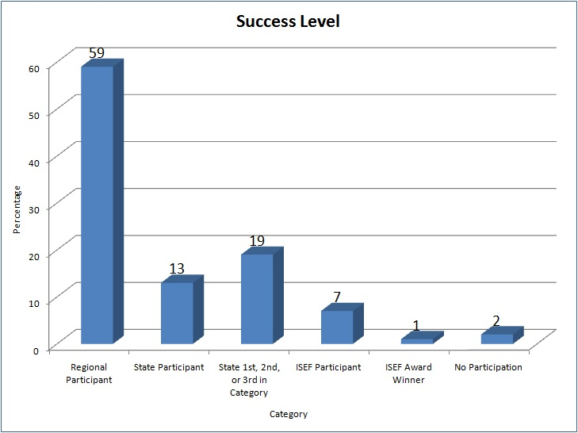
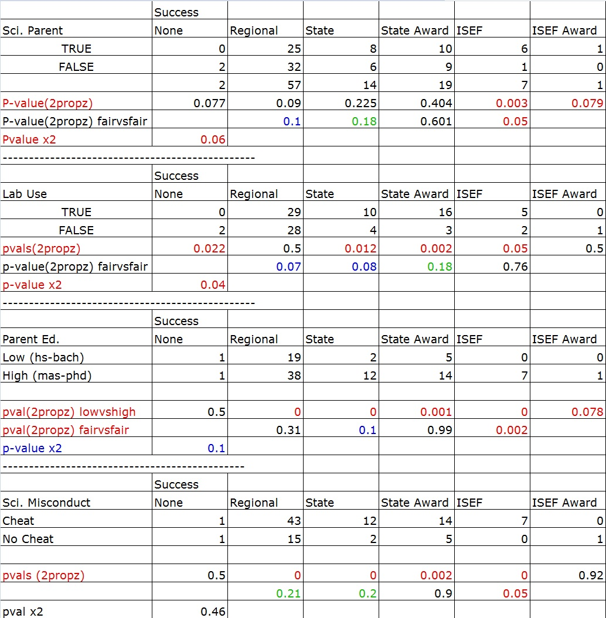
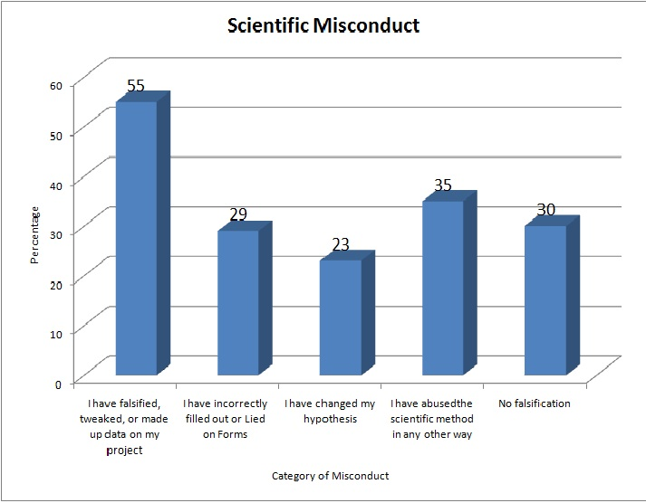

Determining the Practical Range of Bluetooth Low Energy on an iPhone and a Raspberry Pi
Introduction
Methodology
Graph 4: Parental Education
Graph 5: Research Misconduct
Results Cont.
Today’s world is booming with new technology from wearables to drones to technology-infused cars. This multitude of technological advances is becoming so ingrained into our daily lives that our world requires a way to seamlessly and wirelessly interconnect them. Bluetooth Low Energy may just be that system, but its practical range remains uncertain in many situations.
Graph 6: Lab Use
Graph 7: Scientific Parent
Results
Purpose
Table 1: Full Results with Inferential Statistics
Graph 1:
Graph 2:
*
*
Conclusions
Our goal in this experiment was to determine the ideal setup for consistently detecting an iPhone using Bluetooth Low Energy and determine its range. Based off of the results of the first four experiments, the most consistent orientation of the Raspberry Pi is 180º away from the iPhone, or that of experiment C. Even though experiment A picked up a stronger signal, it lacked the consistency over the long distance that experiment C displayed.
Hypothesis
Graph 3:

